Slide 1
Lead Scoring Assignment
By Rama Shankar Sah

Slide 2
Introduction
This case study aims to give us an idea to find the potential Hot Lead Scoring based on the past information provided by the end users. Apply the Machine Learning(ML) technique to find the potential lead end user which can be converted as HOT Lead to the company/ business.

Slide 3
Problem Statement
An education company named X Education sells online courses to industry professionals. On any given day, many professionals who are interested in the courses land on their website and browse for courses.
The company markets its courses on several websites and search engines like Google. Once these people land on the website, they might browse the courses or fill up a form for the course or watch some videos. When these people fill up a form providing their email address or phone number, they are classified to be a lead. Moreover, the company also gets leads through past referrals. Once these leads are acquired, employees from the sales team start making calls, writing emails, etc. Through this process, some of the leads get converted while most do not. The typical lead conversion rate at X education is around 30%.

Slide 4
Problem Statement cont.
Now, although X Education gets a lot of leads, its lead conversion rate is very poor. For example, if, say, they acquire 100 leads in a day, only about 30 of them are converted. To make this process more efficient, the company wishes to identify the most potential leads, also known as ‘Hot Leads’. If they successfully identify this set of leads, the lead conversion rate should go up as the sales team will now be focusing more on communicating with the potential leads rather than making calls to everyone..
X Education has appointed you to help them select the most promising leads, i.e. the leads that are most likely to convert into paying customers. The company requires you to build a model wherein you need to assign a lead score to each of the leads such that the customers with higher lead score have a higher conversion chance and the customers with lower lead score have a lower conversion chance. The CEO, in particular, has given a ballpark of the target lead conversion rate to be around 80%.

Slide 5
Goals Of The Case Study
There are quite a few goals for this case study.
Build a logistic regression model to assign a lead score between 0 and 100 to each of the leads which can be used by the company to target potential leads. A higher score would mean that the lead is hot, i.e. is most likely to convert whereas a lower score would mean that the lead is cold and will mostly not get converted.
2. There are some more problems presented by the company which your model should be able to adjust to if the company's requirement changes in the future so you will need to handle these as well. These problems are provided in a separate doc file. Please fill it based on the logistic regression model you got in the first step. Also, make sure you include this in your final PPT where you'll make recommendations.

Slide 6
Analysis Performed
Below are the steps performed
Load the required python library
Required Library
Load the Data & Data Understanding
Data Cleaning
EDA
Outliers Handling
Data Transformation
Train Test Split
Feature Rescaling
Model Building
Conclusion
Recommendations

Slide 7
Load Data & Cleaning
Read the data from the csv file
Understand the data structure and
Check the data types of cols
Numerical variable distribution etc..
Missing value analysis
Duplicate row details
Clean the data and find the unique value present into the dataset (i.e. duplicate rows of data if any need to drop. But for this use cases we don’t have any duplicate rows) and drop them during the process of data cleaning
Convert sting data into lower case
Replace ‘select’ with NaN
Drop the columns having null values grater equal to 45%

Slide 8
Load Data & Cleaning Cont...
Remove all the columns have near zero variance or imbalance data
Merge the highly skewed categorical variables to single category.
Impute the missing values with ‘not given’ for categorical variables.
The conversion rate into the dataset is 38%
Impute the missing values with median for numerical variables, as we have right skewed data

Slide 9
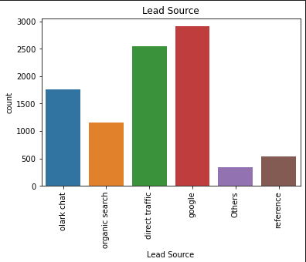
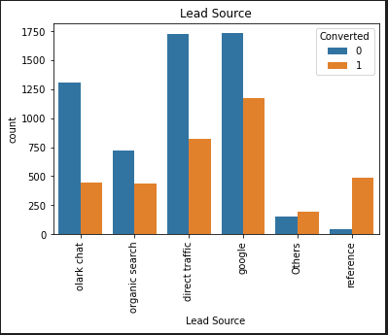
EDA
Exploratory Data Analysis

Slide 10
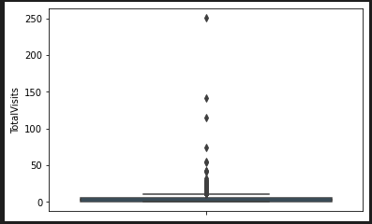
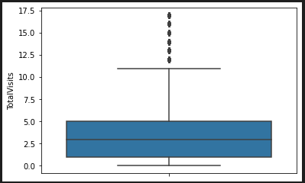
Outliers Handling
Outliers detection for numerical variables and fix using capping upper and lower range. Below images show before Outliers and after removal of Outliers.

Slide 11
Data Transformation
Created dummy variable for categorical variables, and for binary categorical variable used binary_maping to change ‘yes’, ‘no’ with ‘1’, ’0’ and removed all the redundant variables.

Slide 12
Train Test Split
Data is divided into two parts 70% for the training and 30% for test dataset

Slide 13
Feature Rescaling
StandardScaler is used to numerical variable feature rescaling. And correlation matrix is created to find the highly correlated variables.

Slide 14
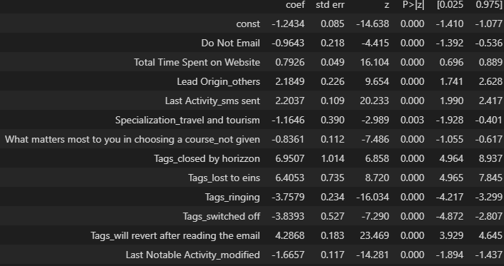
Model Building
Used statsmodels.api for GLM model building
There are total 72 features initially and used Recursive Feature Elimination (REF) and selected only top 15 features for model building.
Train the model using the statsmodels.api as sm for GLM model and recursively removed the column using p-values to select the most significant features and which are contributing more on prediction.
Used Variance Inflation Factor (VIF) to recursively removed the columns which are insignificant and having higher value of VIF score.

Slide 15
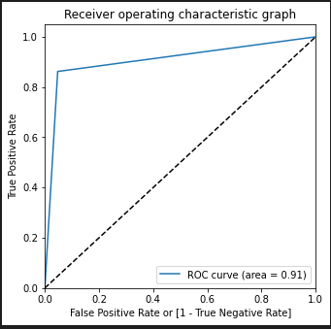
Model Building Cont…
So total 12 significant features are used to predicting the outcome
The equation for ln(odds) is below
ln(odds) = -1.2434 * const -0.9643 * Do Not Email + 0.7926 * Total Time Spent on Website + 2.1849 * Lead Origin_others + 2.2037 * Last Activity_sms sent -1.1646 * Specialization_travel and tourism -0.8361 * What matters most to you in choosing a course_not given + 6.9507 * ‘Tags_closed by horizzon’ + 6.4053 * Tags_lost to eins -3.7579* Tags_ringing -3.8393* Tags_switched off + 4.2868 * Tags_will revert after reading the email -1.6657* Last Notable Activity_modified

Slide 16
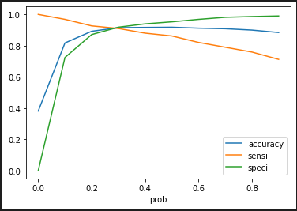
Model Building Cont…
The cutoff probability for the optimal point is .3, so chose the cutoff probability threshold value is .3
Training DataSet
accuracy = 91.8%
sensitivity = 90.9%
specificity = 91.8%
TestDataSet
accuracy = 91%
sensitivity = 92.6%
specificity = 90%
recall = 92.6%
precision = 86%

Slide 17
Conclusion
The Lead score for test dataset is 92% on the final model which indicates very high converting the lead into Hot leads.
The accuracy of test dataset is very high i.e., 91% which makes this model very high to converge the leads into Hot leads accurately.
The three variables in the model which contribute most is
Tags
Last Activity
Lead Origin
The top 3 categorical/dummy variables in the model which should be focused the most on in order to increase the probability of lead conversion are belowmail
  Sjfh
  aksfh
Tags_closed by horizzon
Tags_lost to eins
Tags_will revert after reading the email

Slide 18
Recommendations
Focus more on the ‘Total Time Spent on Website’ and chances are more to get the lead can be converted as Hot leads
Focus more on ‘sms sent’ for last noticeable activity the change is more to get more Hot leads converted.
Tags (i.e. Tags_will revert after reading the email & Tags_closed by horizzon) is very important factors to get Hot lead converted
Target the user with sending email as well as making the calls.

